Slide 1

Predicting customer buying behaviour

Slide 2

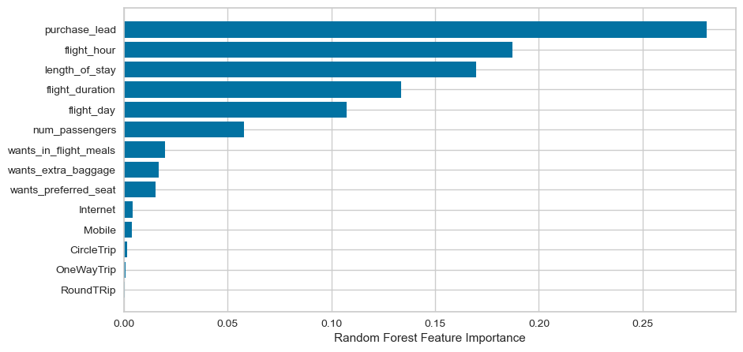
Results after Predictive Modelling using Random Forest Classifier
Top 5 features which influence customer buying behaviour
1.Purchase lead
2.Flight Hour
3.Length of Stay
4.Flight Duration
5.Flight Day
Accuracy Precision
62% 61%

